Slide 1

Project: Mozilla Firefox
Bookmarks or Tabs
Melissa Fallon

Slide 2

Updating the Firefox Bookmark or Tabs Feature Overview
When it comes to browsing the internet, the best way of navigation is either bookmarking sites, or utilizing tabs to keep track of sites.
With these being the most common methods of browsing, where should our focus be on with the the new Firefox update: Developing better bookmark features or tab features?
What will bring about better user satisfaction?
Using the firefox data set, I will be analyzing user data, survey results, and user event activity to understand whether users prefer bookmarks or tabs when browsing the internet.
.

Slide 3

Users Data
Table
Analysis
Total number of users: 27,267
Main user table and metadata associated with each user.
user_id is consistent over all tables
Notes:
SELECT DISTINCT COUNT (id)
FROM users

Slide 4
Events Data
Table
Analysis
Main Table of user recorded events including BOOKMARKS and TAB usage.
2,400,491 events total

Slide 5
Survey Data
Table
Analysis
Total users that completed the survey: 4,081 (or 15% of the 27,267 total users)
New to Firefox: 5.3%
Longtime Users: 90.7%
Users who have Firefox as their primary browser: 82.4%
Target: What fraction use Firefox as their primary browser and are long term users? 76.4% or 3119 users
Notes:
SELECT DISTINCT COUNT(user_id)
FROM survey
SELECT AVG(survey_users)*100
FROM (
SELECT *,
CASE
WHEN a.id = b.user_id then 1
else 0
END AS survey_users
FROM users a
LEFT JOIN survey b
ON a.id = b.user_id)
AS temp;
SELECT AVG(firefox_new)*100
FROM (
SELECT *,
CASE
WHEN CAST(q1 AS int) = 0 then 1
else 0
END AS firefox_new
FROM survey)
AS temp;
SELECT AVG(firefox_old)*100
FROM (
SELECT *,
CASE
WHEN CAST(q1 AS int) >= 3 then 1
else 0
END AS firefox_old
FROM survey)
AS temp;
SELECT AVG(firefox_primary)*100
FROM (
SELECT *,
CASE
WHEN CAST(q4 AS int) <= 1 then 1
else 0
END AS firefox_primary
FROM survey)
AS temp;
SELECT AVG(long_prim_brows)*100
FROM (
SELECT *,
CASE
WHEN CAST(q4 AS int)<=1 AND CAST(q1 AS int)>=3 THEN 1
ELSE 0
END AS long_prim_brows
FROM survey)
AS temp
;

Slide 6
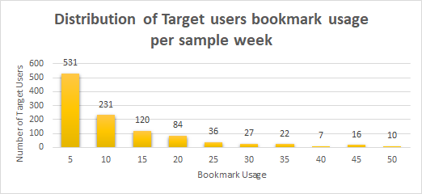
Bookmarks Data Analysis
What's the total number of bookmark actions taken by target users per sample week- 1084
Average amount of bookmarks: 106.71
What's the average number of bookmarks for target users?: 260.9
Target users who launched at least one bookmark during sample week- 937 / 3119 = 30%
What's the average number of bookmark interactions per target user- 9370 / 3119= 3%
Notes:
Average number of bookmarks-
SELECT AVG(CAST(REPLACE(data1,'total_bookmarks', '')as int))
FROM events
WHERE event_code = 8
= 106.71

Slide 7
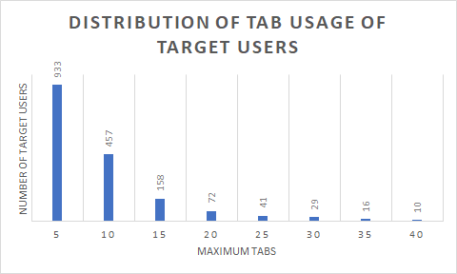
Tabs Data Analysis
What's the total number of tab actions taken by target users per sample week- 1716
Average number of tabs open by target users? 8
Target Users who regularly have more than 10 tabs open: 193 out of 3119 (6%)
Fraction of target users who have ever had more than five tabs open: 37.19%
More than 10 tabs: 18.35%
More than 15 tabs: 10.82%
Notes:
SELECT id, MAX(cast(REPLACE(data2,'tabs','') AS int))
FROM my_target a
LEFT JOIN EVENTS b
ON a.id = b.user_id
WHERE target=1 AND event_code=26
GROUP BY id;

Slide 8
Recommendations
From looking at the data on target users, on average,users prefer to use tabs while browsing firefox instead of utilizing bookmarks
For the new version of Firefox, I recommend focusing more on improving the tabs feature and allowing for the support for users to have a larger number of open tabs.
Next Steps:
Overall, are next area of focus should be on creating more resources for a better tab feature which allows a greater number of open tabs in the Firefox browser.
max growth

Slide 9
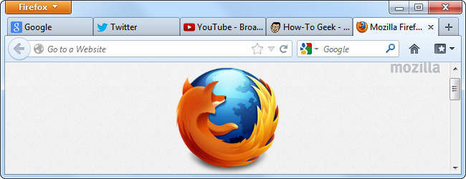
Conclusion: Let’s Focus on Improving the Tabs Feature

Slide 10
Limitations
Target users and sample size does not reflect the majority of Firefox users.
Other underlying issues that play a role in tab usage vs. bookmark usage.

